Slide 1
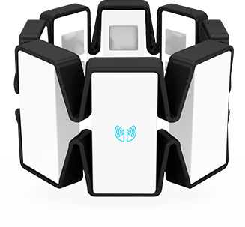

MYO Armband
Created by: Rose Miao ITEC 1301 Fall 2015
Instructor: Natalia Fofanova
University of Houston

Slide 2
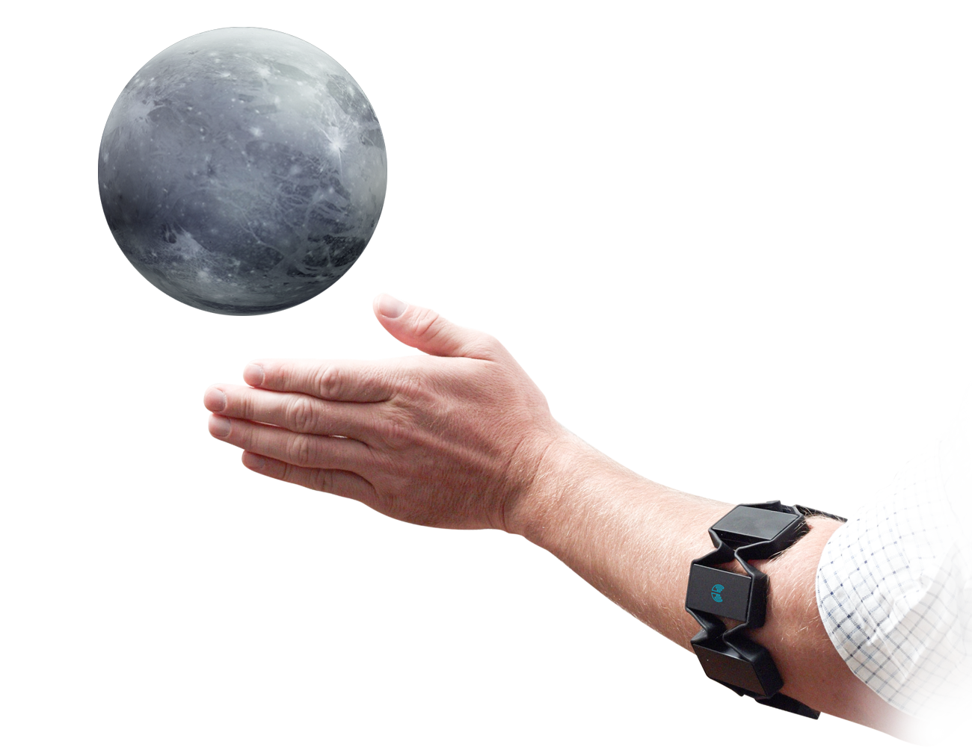
Index
Title
Index
Introduction
The MYO Armband
The Concept
What is MYO?
What does the MYO do?
Credits
The End
Rose Miao

Slide 3



Introduction
Go Coogs!
Click to Play
Hello! My name is Rose Miao and I am a student studying Computer Information Systems here at the University of Houston.
Rose Miao

Slide 4
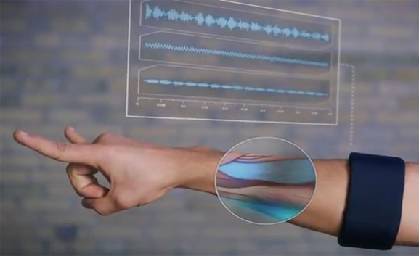
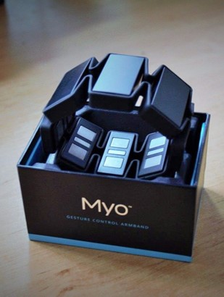
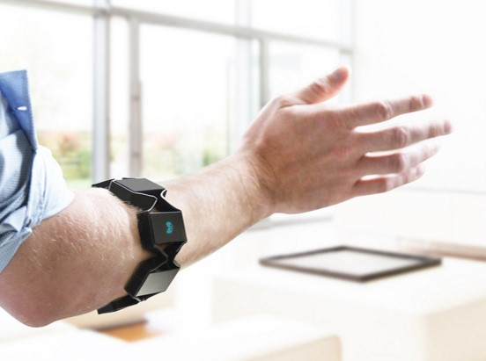
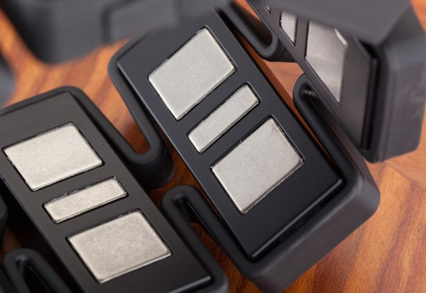
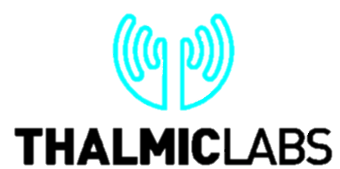
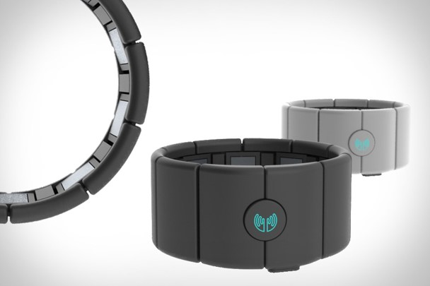
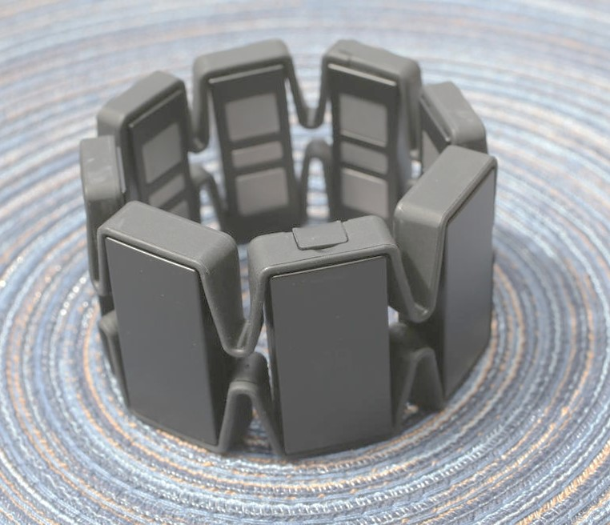
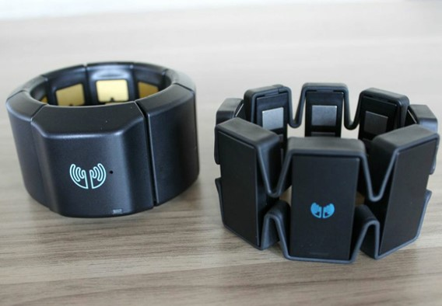
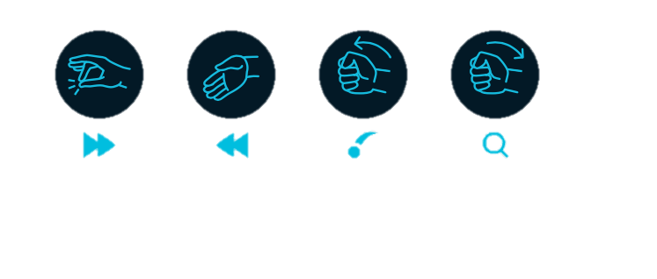
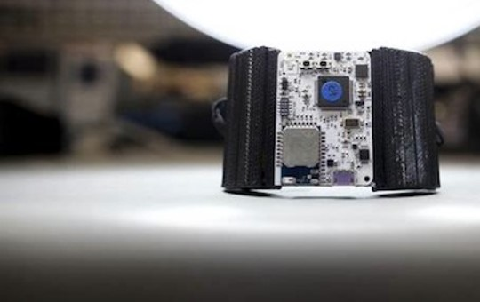
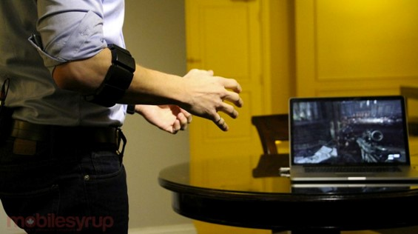
The MYO Armband
Gesture Control Has Arrived…
Rose Miao

Slide 5


The Concept
Please be patient, video is loading…
The idea behind the MYO armband
https://youtu.be/oWu9TFJjHaM
Rose Miao

Slide 6

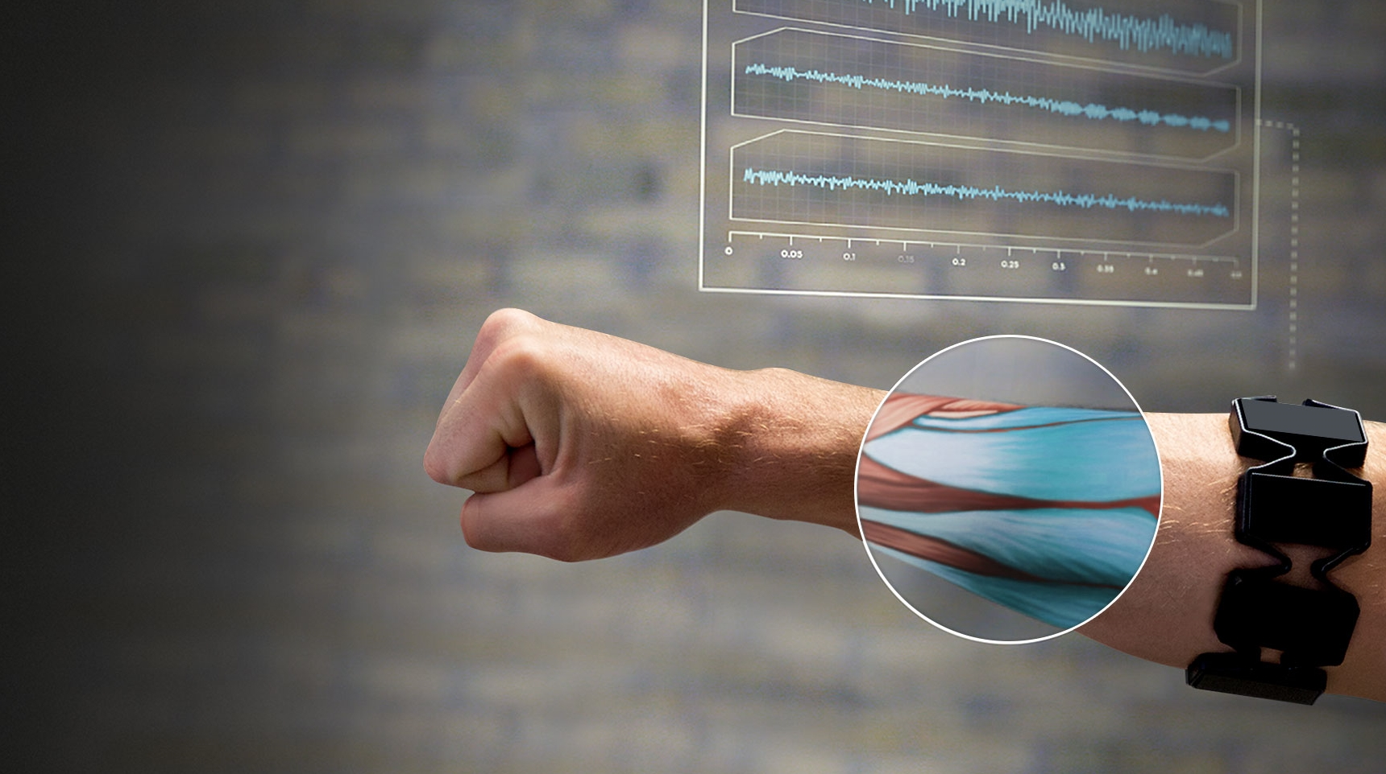
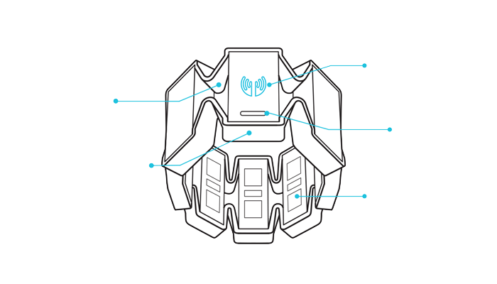
What is MYO?
The MYO is a lightweight armband that uses sensors to track your movements and gestures into input demands
It allows you to wirelessly control devices and gadgets without having the need to hold anything
The armband reads your muscle activity, and can recognize different gestures from horizontal swipes to snapping your fingers
It communicates to other devices using Bluetooth, and lets you take control of applications from a distance
Logo LED
Expandable Flex
Status LED
Micro-USB Charging Port
Electrical Sensors
Rose Miao

Slide 7
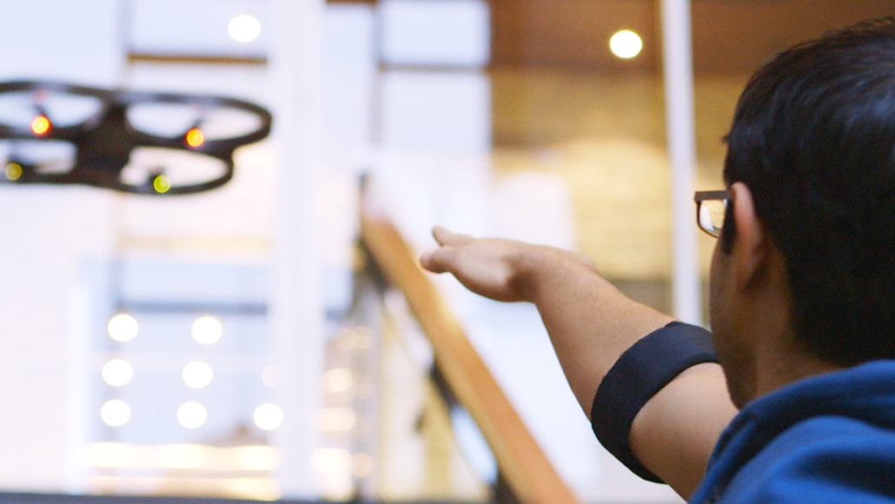

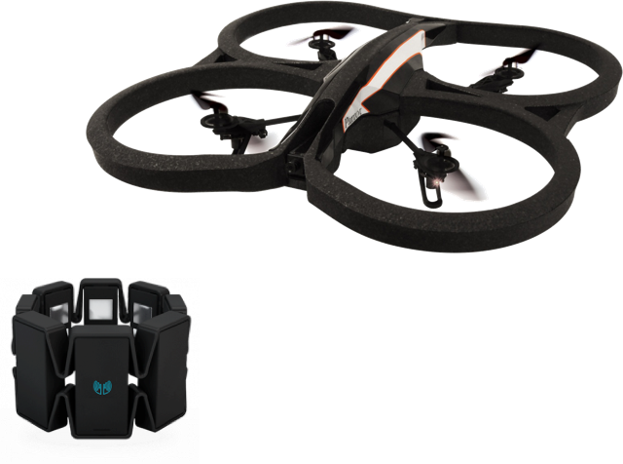
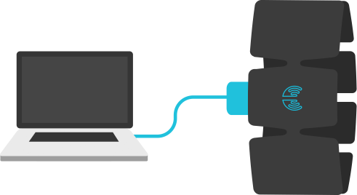
What does the MYO do?
Present
Connect
Play
Control presentations with the flick of your wrist
Compatible with PowerPoint, Prezi, Adobe Reader, etc.
Take control of applications and browse the web
Switch through your music on Spotify or iTunes
Connect and control different kinds of toys such as Sphero and the Parrot drone
Fly or drive toys with hand motions and gestures
Rose Miao

Slide 8
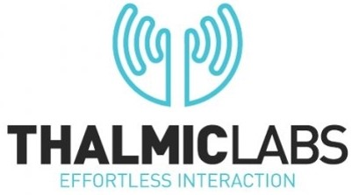
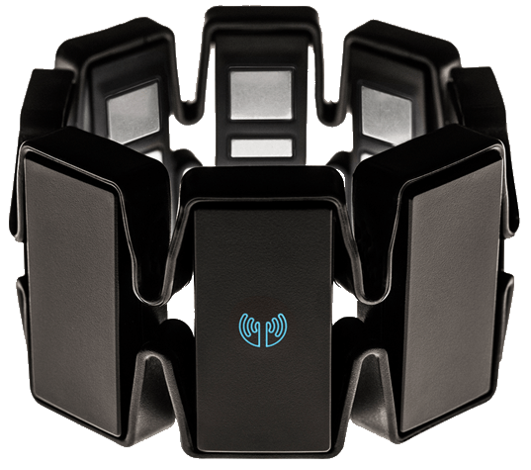
Credits
https://developer.thalmic.com/docs/api_reference/platform/getting-started.html
http://www.geek.com/news/myo-armband-provides-hands-free-controls-by-reading-muscles-1541087/
http://www.medgadget.com/2013/02/myo-armband-uses-electromyography-to-control-external-devices-wvideo.html
http://mobilesyrup.com/2014/01/09/thalmic-labs-shoots-to-kill-with-ces-demo-first-look/
https://www.myo.com/
http://www.pcmag.com/article2/0,2817,2485462,00.asp
http://techcrunch.com/2013/06/05/thalmic-labs-raises-14-5m-to-make-the-myo-armband-the-next-big-thing-in-gesture-control/
http://www.thehindu.com/features/metroplus/myo-the-latest-in-gesture-control/article5937553.ece
http://topwhatsup.com/2015/08/myo-gesture-control-armband.html
https://youtu.be/oWu9TFJjHaM
Rose Miao

Slide 9
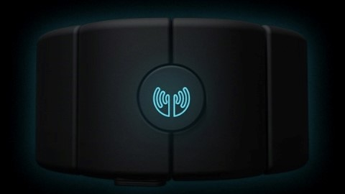
THE END
Thank you for viewing this presentation!
Rose Miao

